Slide 1
Purpose of satire
Makes an argument using comedy
Aims to provoke thought about an issue
Reveals cultural assumptions, prevailing moods, and sometimes real insights about events and trends
Can be visual, musical, print, video, etc.

Slide 2
Satirical Techniques most often used in political cartoons
-Symbolism
-Stereotypes and Caricature
-Irony
-Labeling/captioning
-Analogy
-Exaggeration
-Incongruity (when something is absurd in relation to its surroundings)
-Reversal (when normal order of things is reversed to create humor; “order” can refer to chronological, hierarchical, etc.)
-Parody

Slide 3
A LITTLE HISTORY ON POLITICAL CARTOONS AS A FORM OF SATIRE…

Slide 4
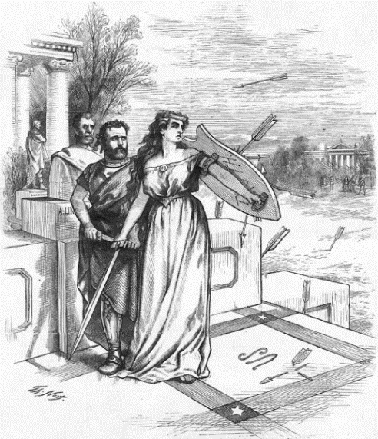
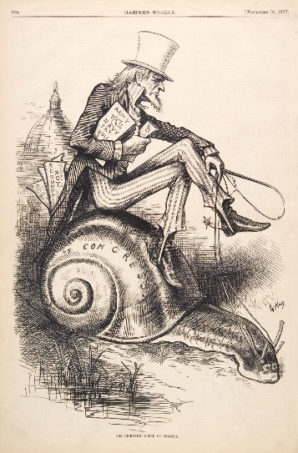
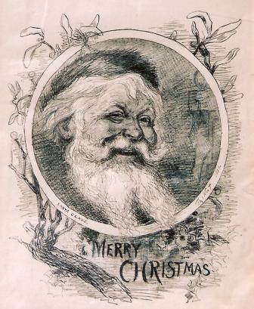
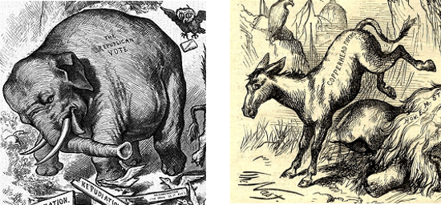
Thomas Nast
1840 - 1902
German-born American caricaturist and editorial cartoonist
considered to be the "Father of the American Cartoon"
Criticized Boss Tweed and the Tammany Hall political machine
Among his notable works were the creation of the modern version of Santa Claus and the political symbol of the elephant for the Republican Party.
Contrary to popular belief, Nast did not create Uncle Sam (the male personification of the American people), Columbia (the female personification of American values), or the Democratic donkey, though he did popularize these symbols through his art.
Nast was associated with the magazine Harper's Weekly from 1859 to 1860 and from 1862 until 1886.

Slide 5
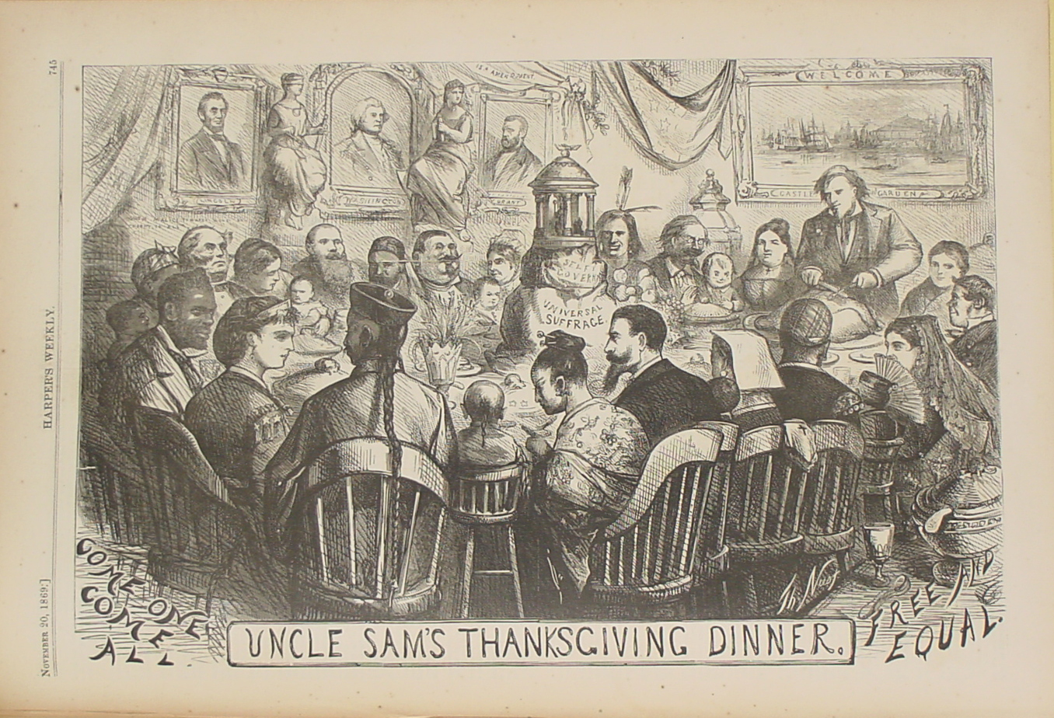
What do you notice?

Slide 6
Content/Context/Techniques/Satire
“Uncle Sam’s Thanksgiving Dinner”
Showcases Nast’s Reconstruction-era idealism
Indirectly references the Fourteenth Amendment, which secured equal rights and citizenship for all Americans, through labeling (free and equal)
Indirectly references the Fifteenth Amendment, which forbade racial discrimination in voting rights, through labeling (universal suffrage)
Citizens of various backgrounds are depicted here through the artistry, and are getting along at the dinner table
This cartoon also features several symbols to further the cartoonist’s ideology: Uncle Sam (head of the table), Columbia (in the statue), the portrait of Washington, and the portrait of Lincoln

Slide 7
What do you notice?

Slide 8
Content/Context/Techniques/Satire
“Tammany Tiger”
In 1871, the Republican New York Times ran a scathing series of exposés of corruption in the Tammany Hall-controlled Democratic administration of New York City
Harper’s Weekly and Thomas Nast quickly joined the campaign
In the cartoon, there is much symbolism: a bloodthirsty Tammany tiger has mauled the Republic, symbolized by Columbia, having broken her shield, the ballot, through corruption.
The hyperbolically rotund emperor, Tammany Boss William Magear Tweed, enjoys the spectacle, sitting among other well-known Democratic politicians.
An allusion to the historic slaughter of innocent Christians in Roman arenas is also evident in the image.
No labeling in this cartoon---all the satire is communicated through artistic techniques.

Slide 9
Clearly, context is essential in being able to decipher all the elements of a political cartoon and truly understand its satire.
When you analyze political cartoons, make sure to research any context with which you are unfamiliar in order to fully comprehend their message.

Slide 10
What do you notice about content, context, techniques, and satire in the following contemporary political cartoons?

Slide 11
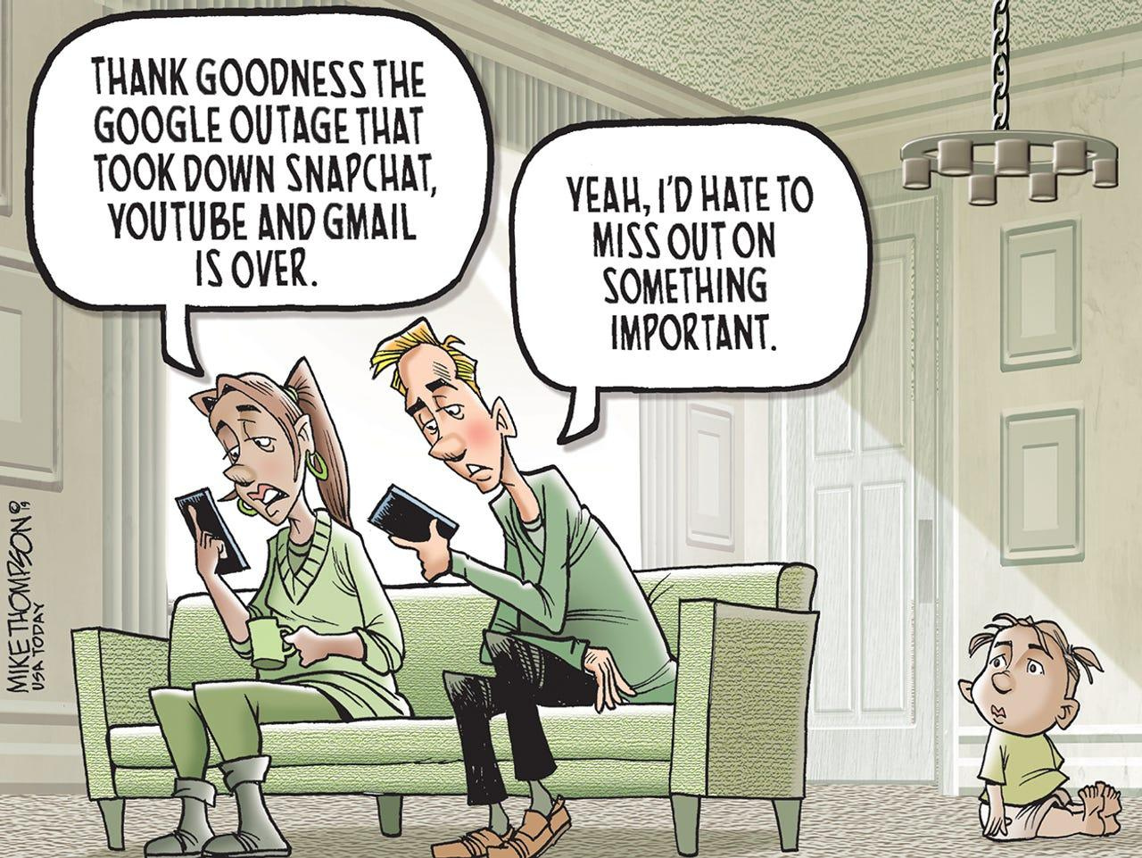

Slide 12
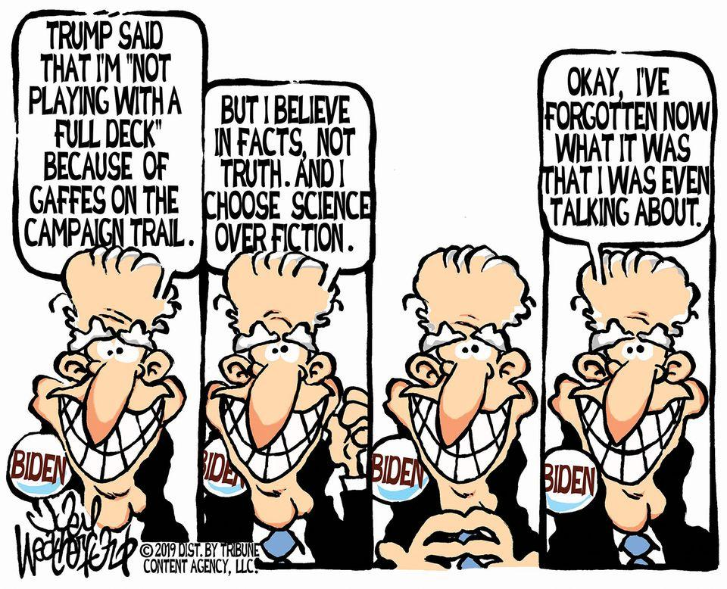

Slide 13
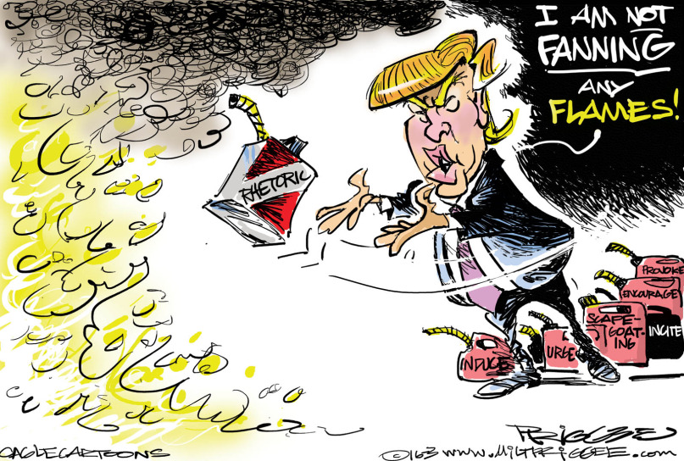

Slide 14
What appear to be the main differences between older and newer political cartoons?

