Slide 1
EFFECTIVE WRITING
Structuring a thesis statement
Structuring an opening and closing paragraph
Structuring a body paragraph

Slide 2
Structuring a Thesis Statement

Slide 3
In the process of prewriting there are three questions to answer - WHAT?, WHY?, AND HOW?
Note: These are three different questions from the What?, How? And Why? of a good paragraph!

Slide 4
ALWAYS identify your overarching idea first! This is the WHAT?
WHAT is the author trying to communicate? This is the overarching idea, theme, or message of the selection.
Next you need to identify the WHY?
WHY is the author trying to communicate this point? This will offer depth to your thesis statement AND your paper.
Finally consider the HOW?
HOW does the author go about the process of achieving the overarching idea? What literary devices are employed in order to communicate the OAI?

Slide 5
Prewriting will help you identify the literary focus of your paper. Once you begin drafting the answers to these questions you can create a graphic organizer. This is a sample from The Lord of the Flies.

Slide 6
Prewriting a Thesis Statement
What? OVERARCHING IDEA
Dysfunction of Anarchy
Why? To prove we need social rules to survive.
How? Supporting Literary Elements
Character
Setting
Symbolism
* Complete worksheet in class

Slide 7
Basic Format
In the novel _______________ written by ________________ the author uses ____________, ___________, and ____________ in order to (demonstrate) ____________________________________.
In the novel The Lord of the Flies written by William Golding, the author uses character, setting and symbolism to prove that anarchy breeds dysfunction and that we need social rules to survive.

Slide 8
Structuring Opening and Closing Paragraphs

Slide 9
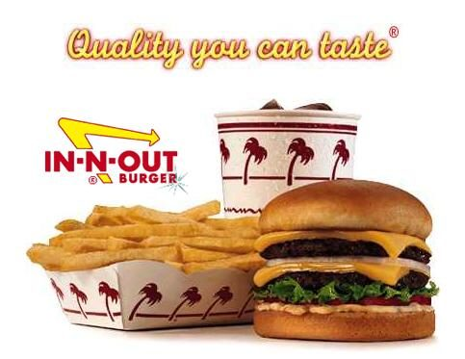
Gotta have tight buns!
If you don’t have tight buns, all the meaty, cheesy
goodness in the middle will fall apart!

Slide 10
These can prove to be the most important part of your essay!
Opening Paragraph Basics
Closing Paragraph Basics
HOOK, universal statement, brief summary, or background.
BRIDGE – a transition from your intro to your thesis statement.
THESIS – The purpose of your essay.
PROOF POINTS – The literary elements that support your thesis.
TRANSITION - to body
Link or tie-back to your hook or opening.
Restatement of your thesis.
Final thought, twist, concluding statement.

Slide 11
Example Opening Paragraph
[HOOK] John Lennon once said, “all you need is
love.” [Br.] This message seems to be universal in
music as well as literature. [THESIS] In Of Mice and
Men by John Steinbeck, he presents the theme of love
through the relationships he develops within the story.
[PPs] Examples of this message surface between
Lennie and soft items, the crew in the bunk house, and
most importantly, between Lennie and George.
[Tr.] The deeper these relationships are explored, the
more we can see the universality of the need for love.

Slide 12
Example Closing Paragraph
[Tie Back] Throughout the ages songs have referred to our innate need for love. [Restatement] John Lennon stated it simply, but perfectly in his song. Simply and perfectly Steinbeck also demonstrates the theme ‘the need for love’ in his book Of Mice and Men. [Twist/Final Statement] It is startling that a concept so widely understood and universally needed is so hard to recognize and attain.

Slide 13
Structuring Body Paragraphs

Slide 14
Effective writing contains three major components:
Textual Truths – WHAT? What is happening in the story that is worthy of discussing?
Evidence – HOW? How does the author demonstrate this truth (quote or paraphrase)
Commentary – WHY? Why is this important to the overarching idea? The author’s purpose?

Slide 15
Basic Structure
Use this “recipe” if you feel that your writing is weak:
TS - Topic Sentence: This should refer to your first proof point and introduce what the topic of your paragraph is going to be about.
TT – Textual Truth: This will be your first example from the book. Introduce your evidence in your own words.
EV – Evidence: quote or paraphrase that supports your CD (use citations).
CM (x2) - Commentary: These are thoughtful insights and reflections regarding the evidence you just provided. The commentary often shows the connection between the evidence and the focus of your paper.
Transition: This is a sentence or phrase that will lead you into your next TT.
TT – 2nd example (repeat)
EV – 2nd quote (repeat)
CM(x2) – 2nd commentary (repeat)
CS – Concluding Sentence: Briefly sums up the content in the paragraph and/or transitions you into the next paragraph.

Slide 16
Sample Paragraph
(TS) The symbols that represent social order are critical in understanding Golding’s novel. (CD) The conch is a symbol of social equality. (EV) In the beginning of the novel Piggy insists, “if you have the conch, people have to listen to you!” (15). (CM#1) The shell is not only a physical representation of a proposed code of conduct, but it also represents the boys desire for order. (CM#2) This supports the idea that Golding is trying to communicate that anarchy breeds dysfunction. (Tr.) In addition, the fire is also a significant symbol used in the novel. (TT) The fire can be interpreted as a symbol of survival. (EV) Jack hoards the fire and says, “you can have it if you join us.” (127). (CM#1) His control over the fire can also be seen as his control over Piggy and Ralph’s survival. (CM#2) This control goes to the heart of Golding’s message. (CS) Symbolism proves to be an effective way of communicating the theme of the novel.

Slide 17
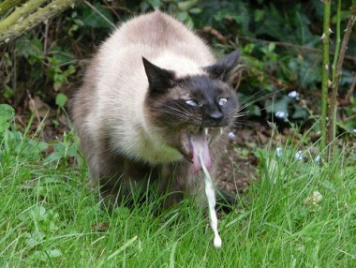
Bottom Line …
You need to be the most critical evaluator of your work. If you need to follow a strict recipe – do it!
If you feel comfortable with the basics – explore your writing prowess. Reorder, rearrange, reconsider – but don’t lose sight of the original recipe or you will get …

