Slide 1
Visual Literacy + Propaganda Art: WWII Victory Gardens
Alana Bond and Seana Mekari
11IB Year 1

Slide 2
What are different forms (genres) of visual communication?
Discuss
TV, movies, short clips, YouTube
Ads – newspapers, posters, fliers, magazines
Logos, bumper stickers, pins, signs
Clothing, brands, hair
Crowds of people, mobs, rallies

Slide 3
What can be interpreted/analyzed through visual literacy?
Discuss
Message being communicated
Vibe/image/persona/body language
Cultural/social information
What is factual vs. what is false
Decency/appropriateness
Tone/attitude

Slide 4
Visual literacy can be analyzed in terms of:
Syntax: organization/arrangement/structure/style
Semantics: its various meanings and connotations
The syntax of the visual impacts its semantics (the way it is interpreted).

Slide 5
Visual syntax terms
Font (bold, italics, style, size, sans)
Scale and dimension
Motion
Arrangement/layout (balance b/w text and image)
Framing/zooming/cropping
Relative size of items within images
Captioning
Labeling
Harmony, contrast, emphasis
Resemblance
Juxtaposition of images
Depth, color, light, shadow
Filled space (vs. purposeful white space)
Symbolism

Slide 6
When analyzing visual semantics – aspects to consider:
Subject matter
Cultural context
Structure (how it’s organized)
Techniques used to produce it
Aesthetic merit (effective graphic design?)
Purpose and audience
Merit in terms of communicating purpose and reaching intended audience
Emotional impact
Bias/traces of manipulative intent

Slide 7
Core assumptions (keep these in mind when you analyze visuals):
1. All media messages are constructed.
2. Media messages are constructed using a creative language with its own rules.
3. Media messages have embedded values and points of view.
4. Most media messages are organized to gain profit and/or power.
5. Different people experience the same messages differently.

Slide 8
Key Questions to answer in order to understand the semantics of a visual (the aspects listed previously would be embedded in the responses to these questions)
Who created this message and why?
What techniques are used to attract my attention? Alternatively, are any techniques misused or distracting?
Who is the intended audience? Does the message reach them?
How might different people understand this message differently from me?

Slide 9
PROPAGANDA
NOUN
1 Information, especially of a biased or misleading nature, used to promote a political cause or point of view. (Oxford English Dictionary)

Slide 10
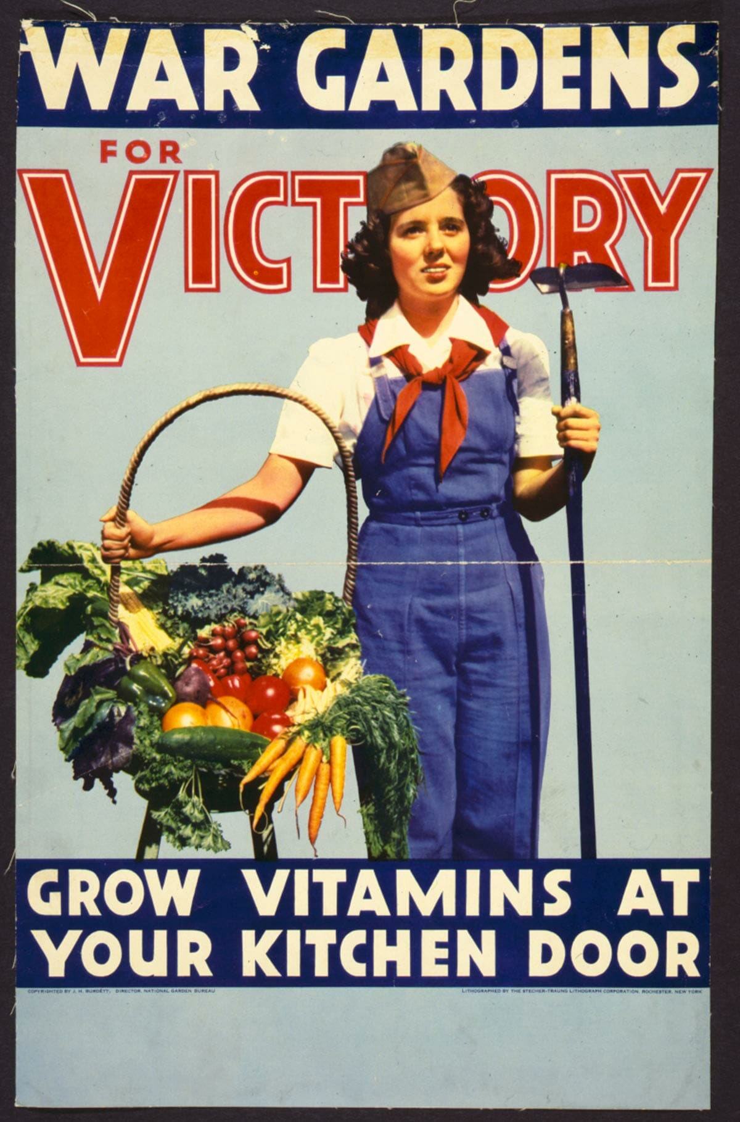
Slogan: "Grow Vitamins At Your Kitchen Door"
Context: With commercial farms steering more and more of their products to the troops, and trucks and transit focused on war work, it became more and more imperative for amateur farmers to produce vegetables and other foodstuffs closer to home – in backyard gardens, neighborhood plots, and even window boxes.
Credit: CBSNews.com senior producer David Morgan

Slide 11
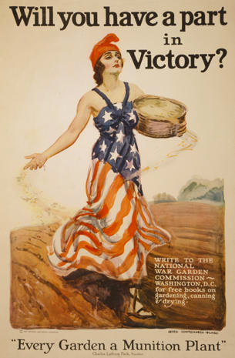
Slogan: “Will you have a part in victory?”
Context: After the end of WWI, the government continued to encourage Victory Gardens as a means of avoiding famine at home and in Europe as a result of the war.
Credit: Library of Congress

Slide 12
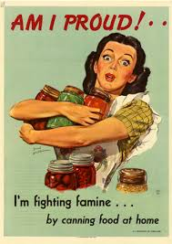
Slogan: "Am I Proud!” "I'm fighting famine by canning food at home.”
Context: World War II poster from the U.S. Department of Agriculture.
Credit: University of North Texas

Slide 13
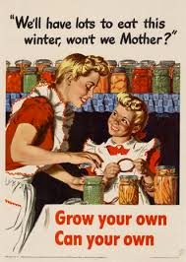
Slogan: "Grow Your Own - Can Your Own"
"We'll have lots to eat this winter, won't we Mother?”
Context: World War II poster from the U.S. Office of War Information.
Credit: University of North Texas

Slide 14
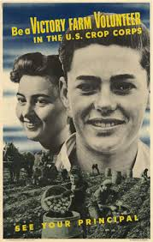
Slogan: “Be a Victory Farm Volunteer in the U.S. Crop Corps
Context: A 1943 Department of Agriculture poster calling on students to contribute to farm labor efforts.
Credit: University of North Texas

